Slide 1
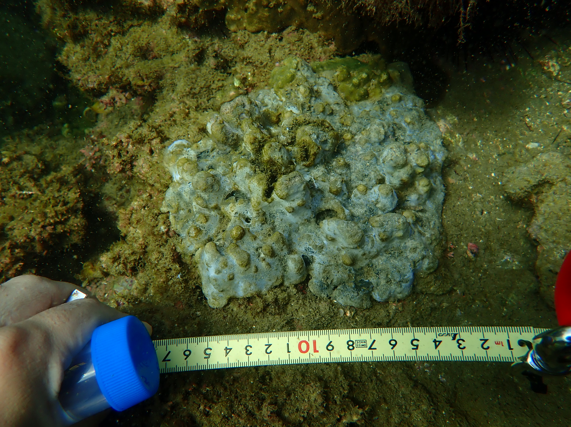
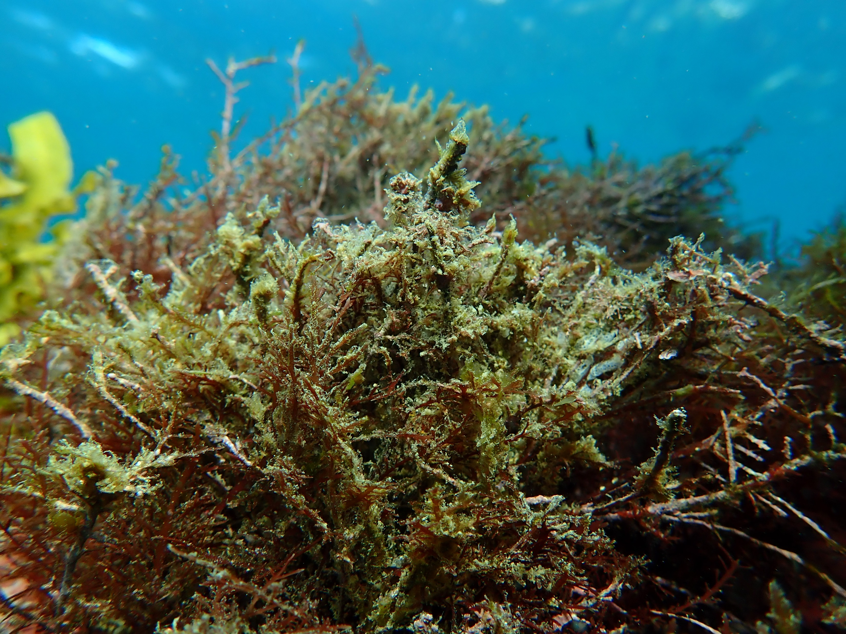
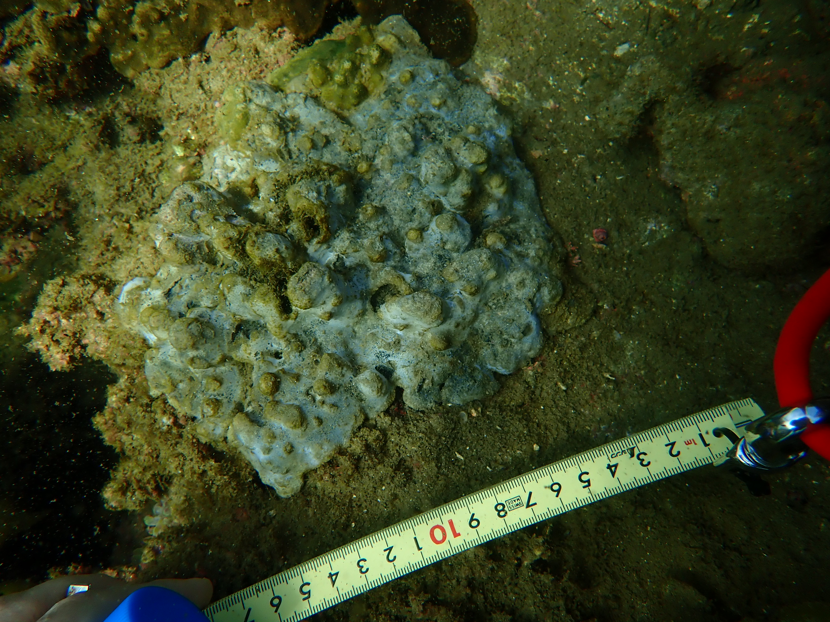
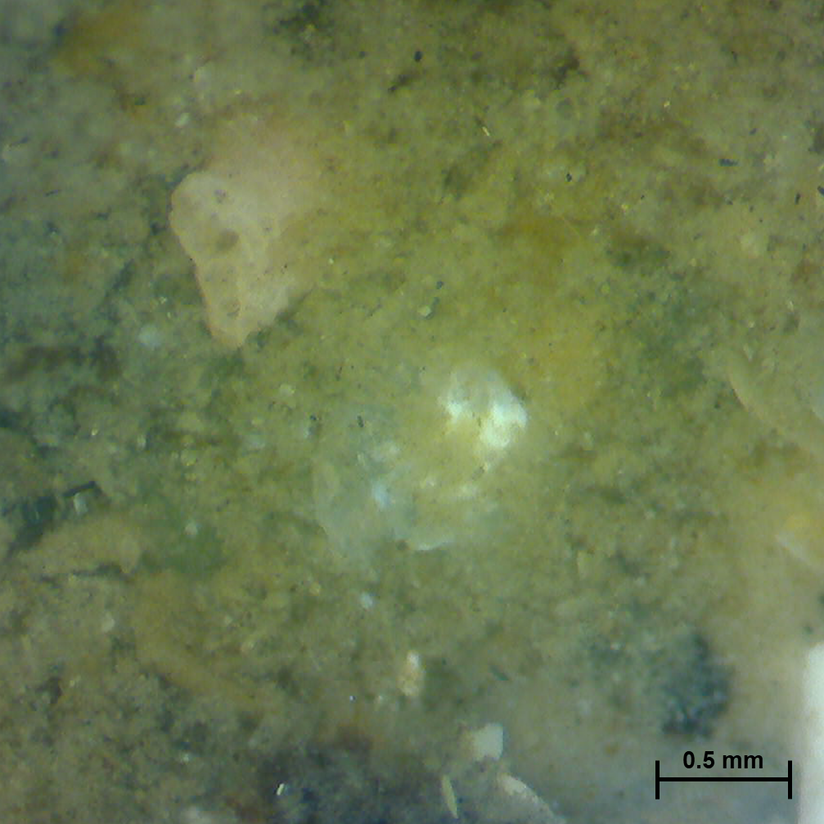
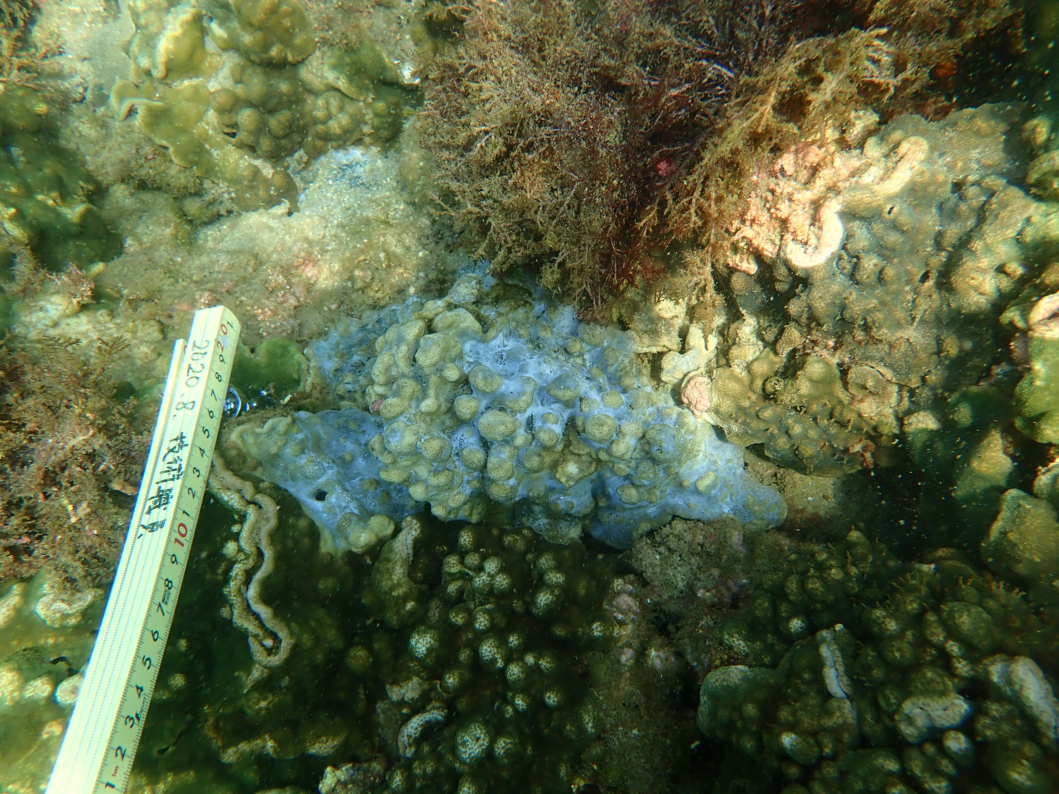
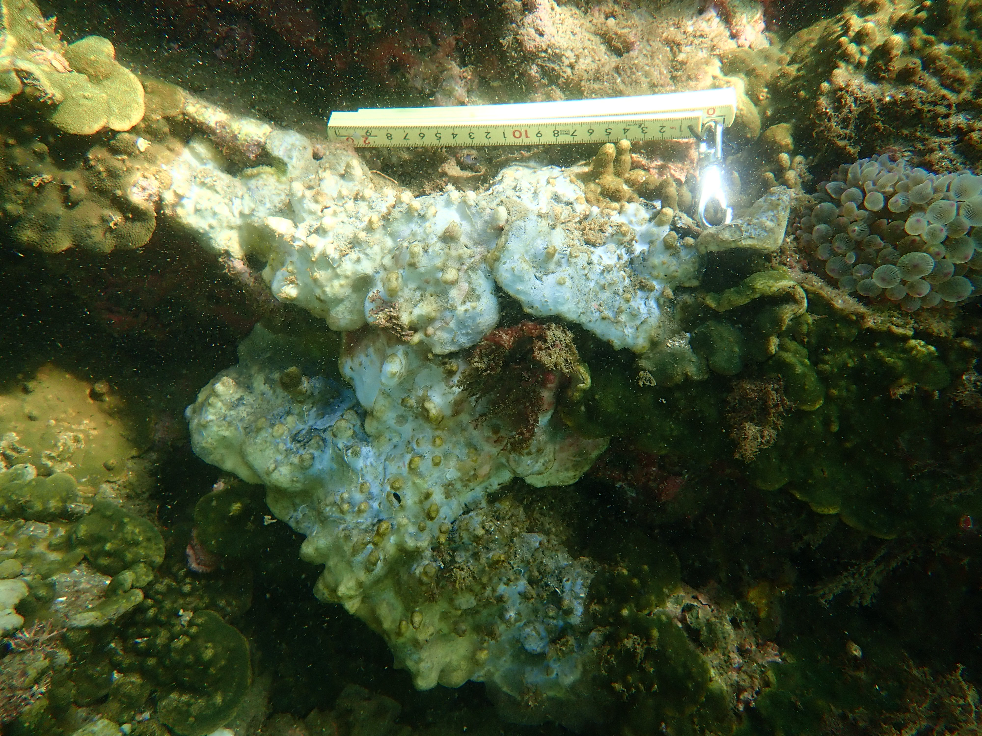
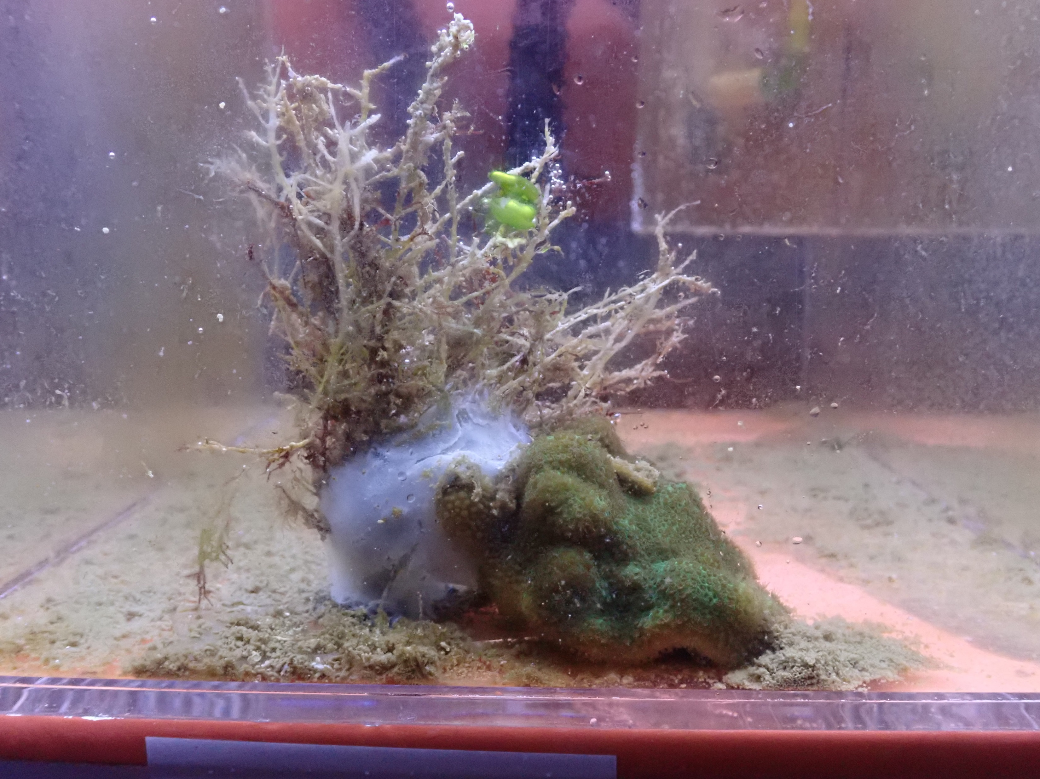
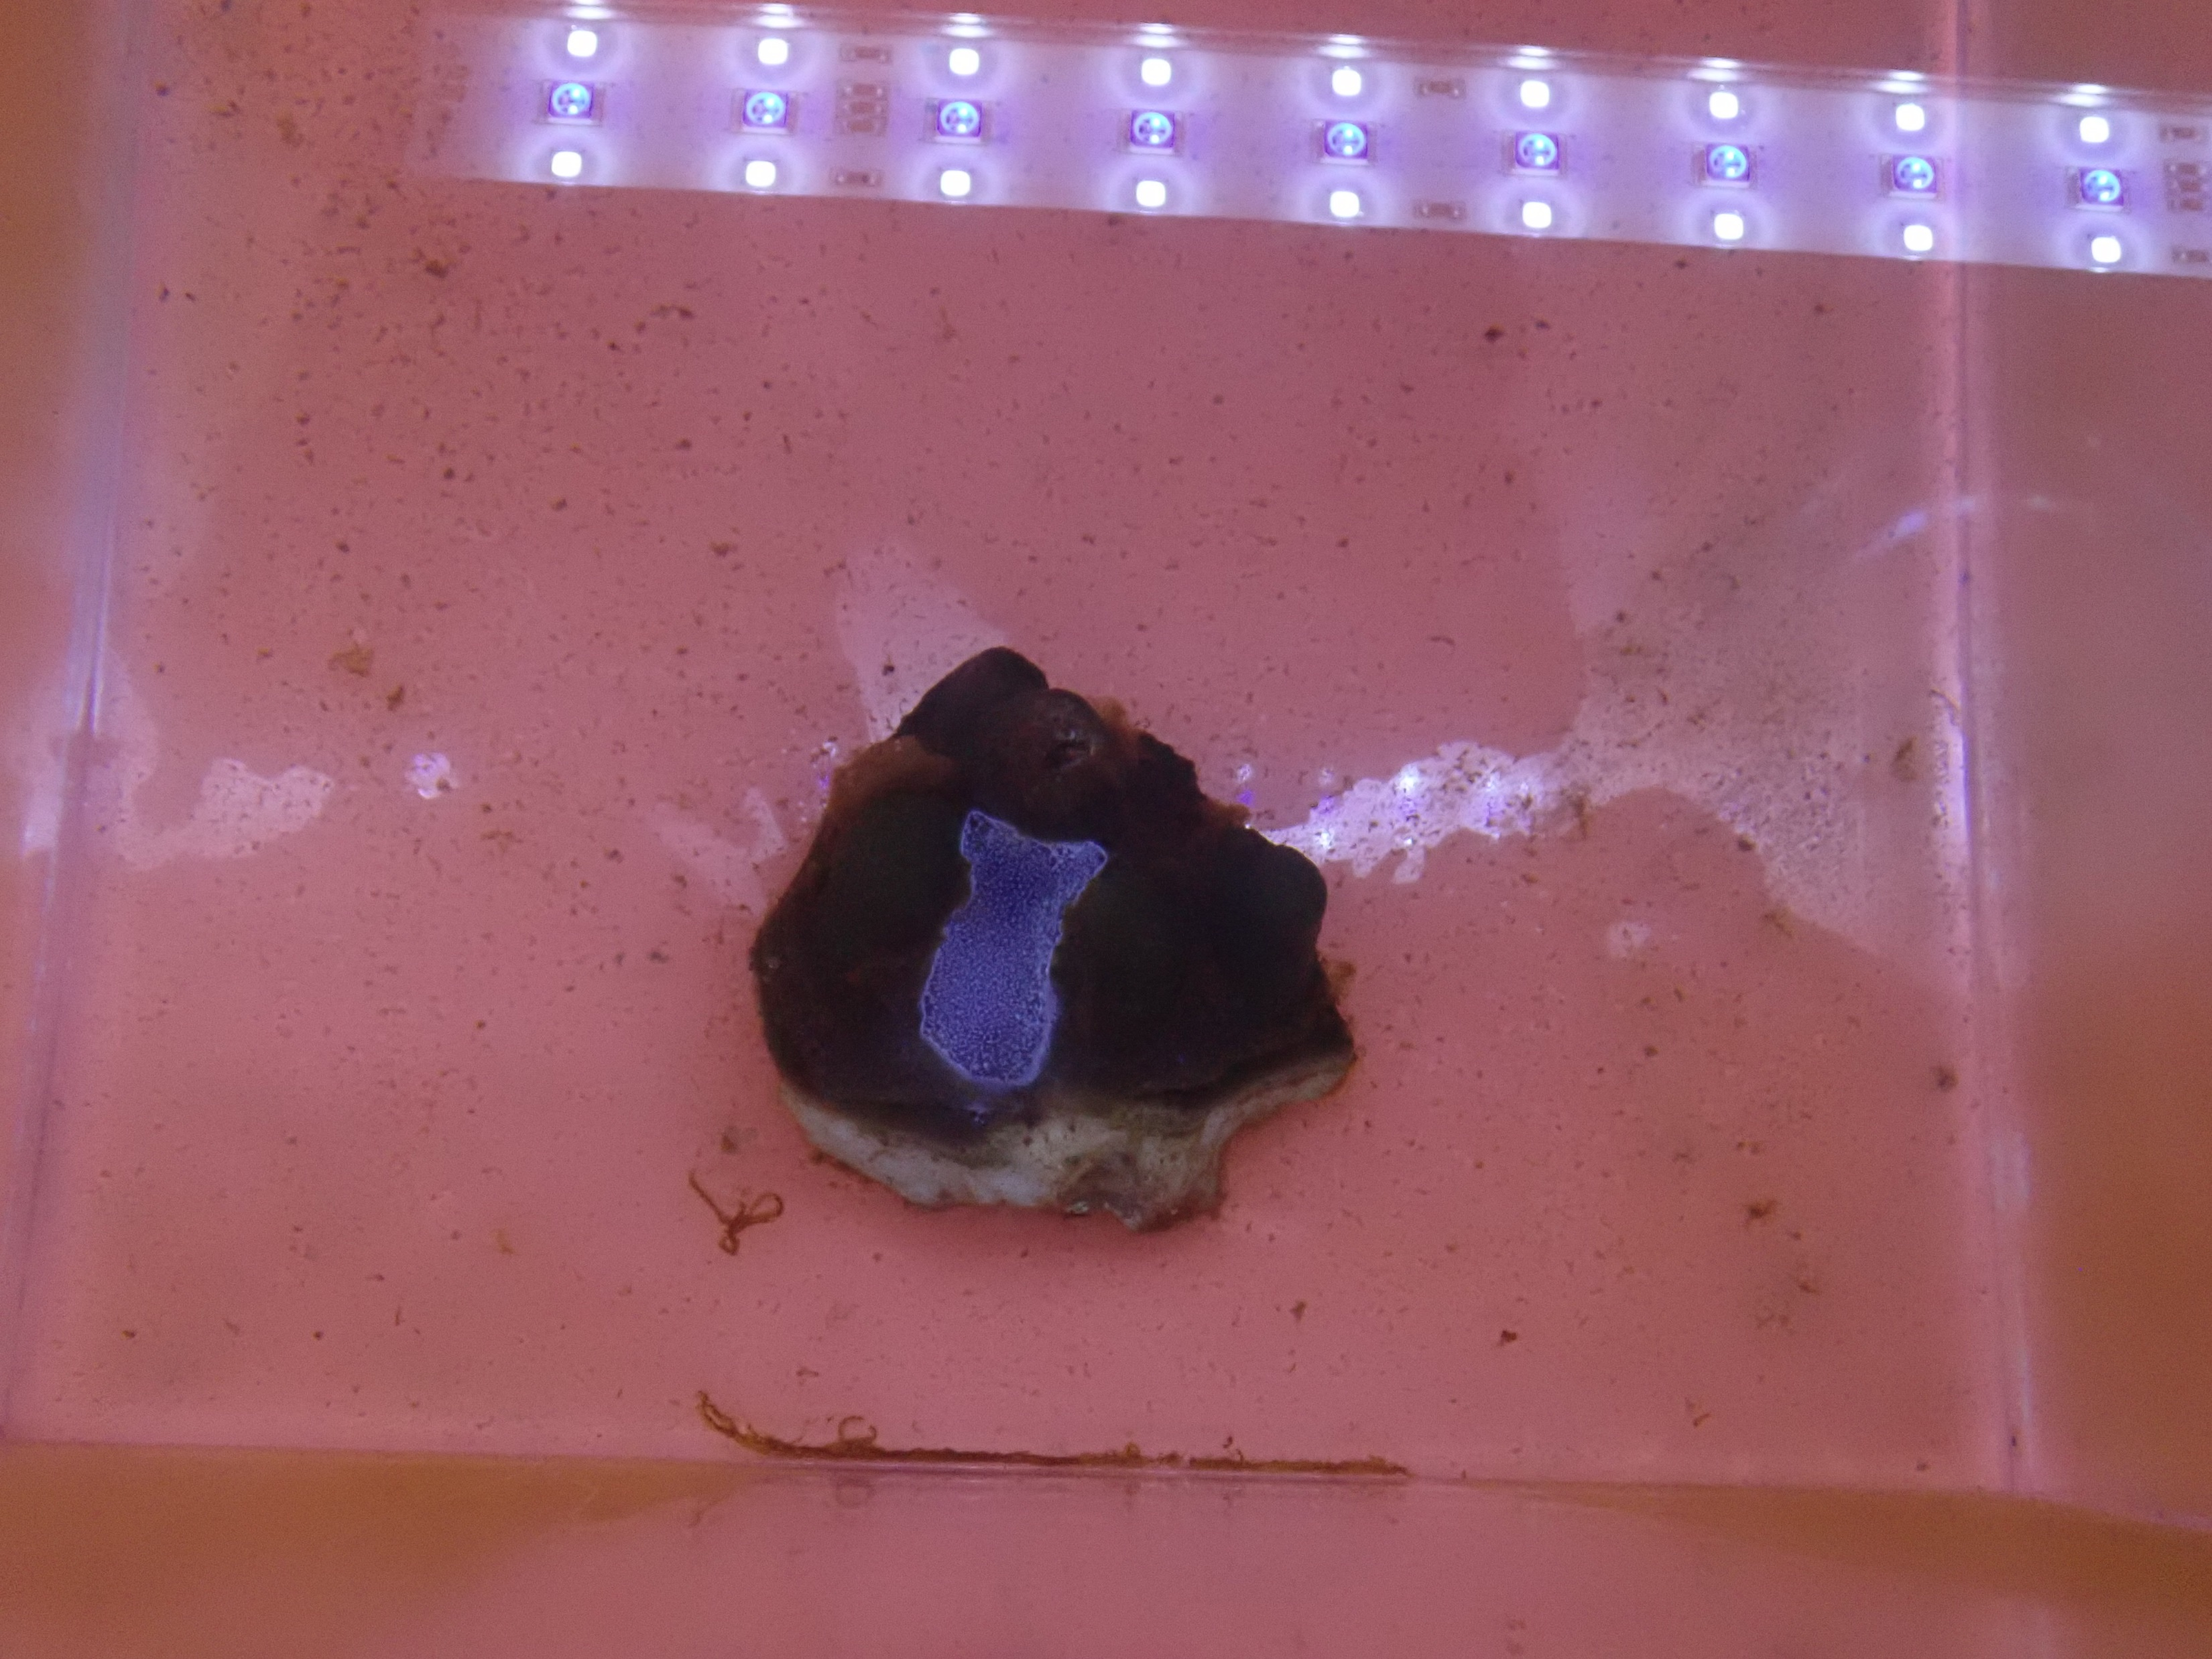
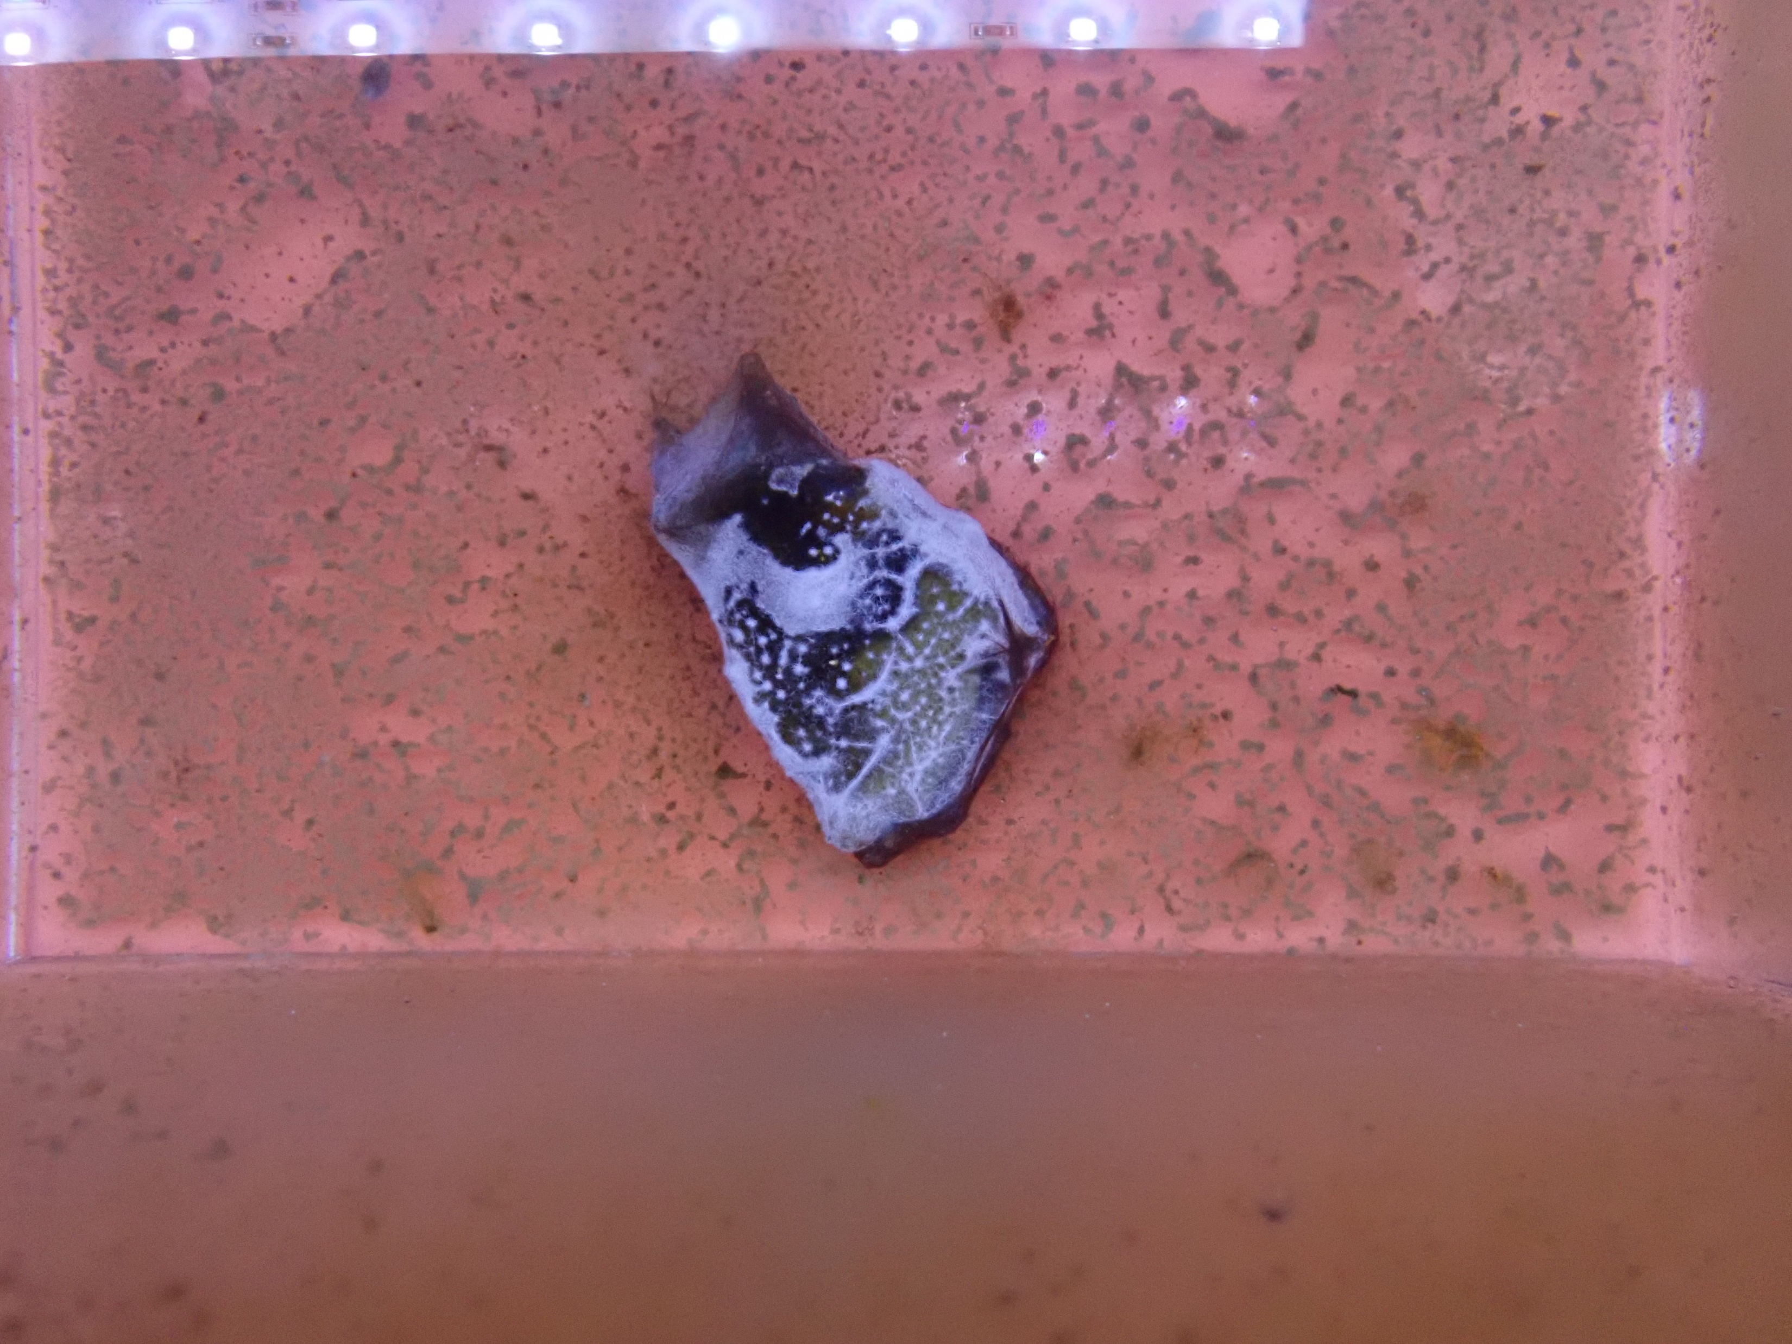
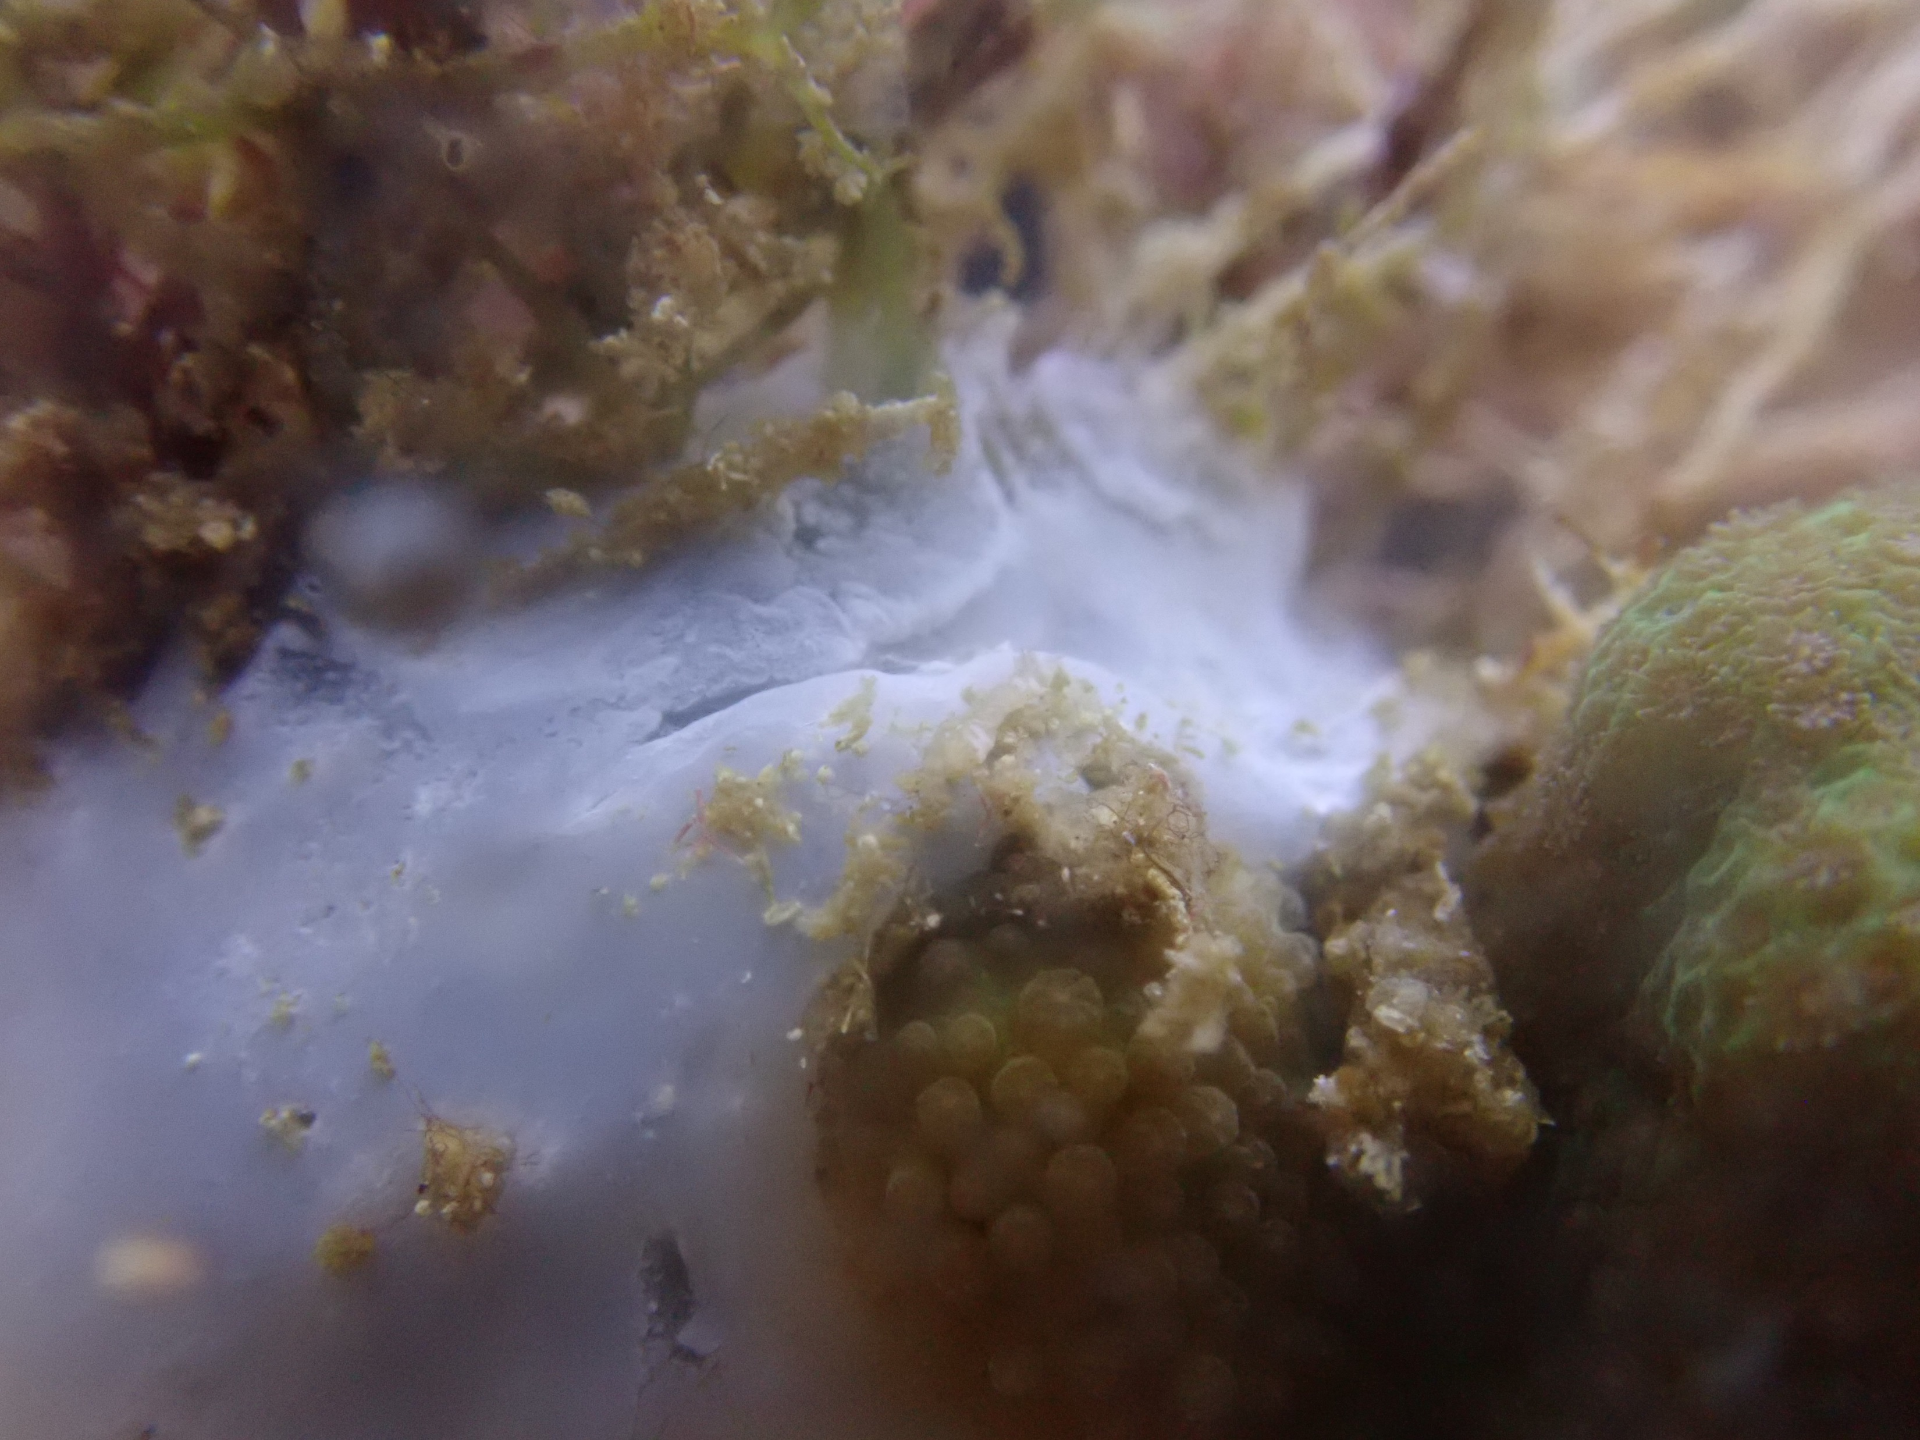
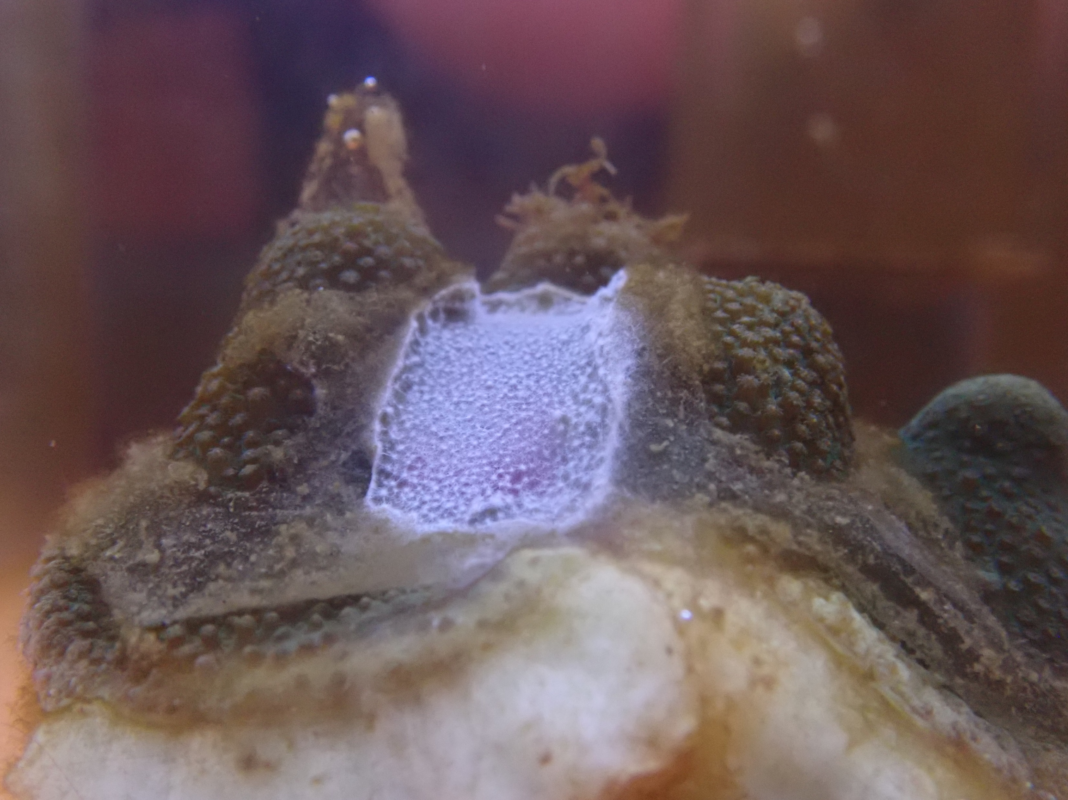
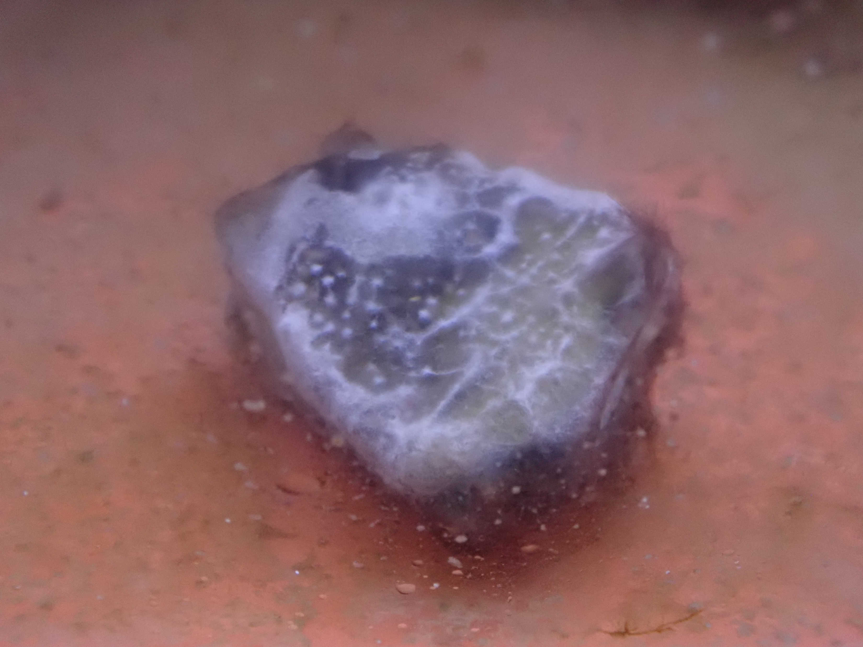
Field
G. elegans
WMS
Field samples (start)
G. elegans
Sediment
WMS
WMS
White Mat Syndrome
Gelidium elegans
Sediment
Summer incubation (end)
G. elegans paired
WMS fragment
(injured)
WMS fragment

Slide 2
Field samples
used for summer incubation exp. treatments (start)
WMS-like lesions
Infections observed in the summer incubation exp. (end)
WMS
White Mat Syndrome
Gelidium elegans
Sediment
G. elegans paired
WMS fragment
WMS fragment
(injured)
Field samples
used for summer incubation exp. treatments (start)
WMS-like lesions
Infections observed in the summer incubation exp. (end)
WMS
White Mat Syndrome
Gelidium elegans
Sediment
G. elegans paired
WMS fragment
WMS fragment
(injured)

Slide 3
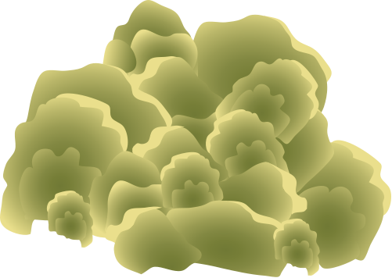
G. elegans
Sediment
WMS

Slide 4
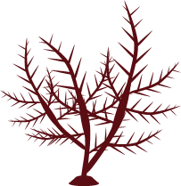
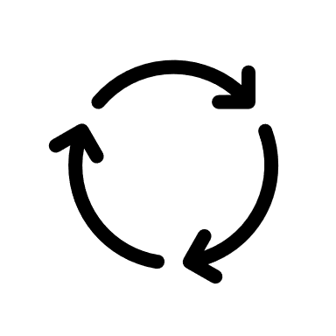
Algal senescence
Winter
Spirochetes
Desulfo- groups
Arcobacter
Thiotrichaceae

Slide 6


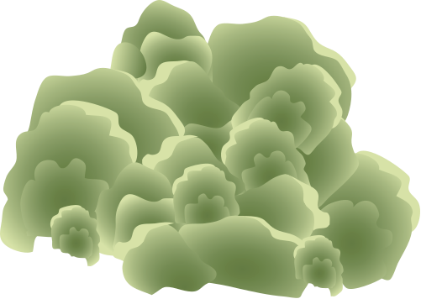
Bacteria-induced algal senescence
Hudson and Egan, 2022
WMS microbial community
C/N/S cyclers
Propionic acid bacteria (PAB)
Bacteroidetes
Thiotrichaceae
Beggiatoaceae
Propionigenium sp.
CO₂
Acetate
High summer temperatures
Healthy G. elegans
Senescing G. elegans
Sulfurimonadaceae
Arcobacteraceae
Spirochaetaceae
Desulfobacter sp.
Direct contact
Indirect contact / fragmentation
Primary transmission
Secondary transmission

